Slide 1

.
CHIPATON 2026 TRACK B : CIRCUITS FOR SENSOR
B18: PROBTON
ASIC Solution for Optical Probe Station for Photonic Integrated Circuits Packaging and Testing
- TEAM MEMBERS -
TIM LAM • VICTORIA TJHIN • ABRAAR ALAM
BELKACEM BENADDA • NITIN INDUKURI • REZA SETIABEKTI • ASHMITA SAHA

Slide 2

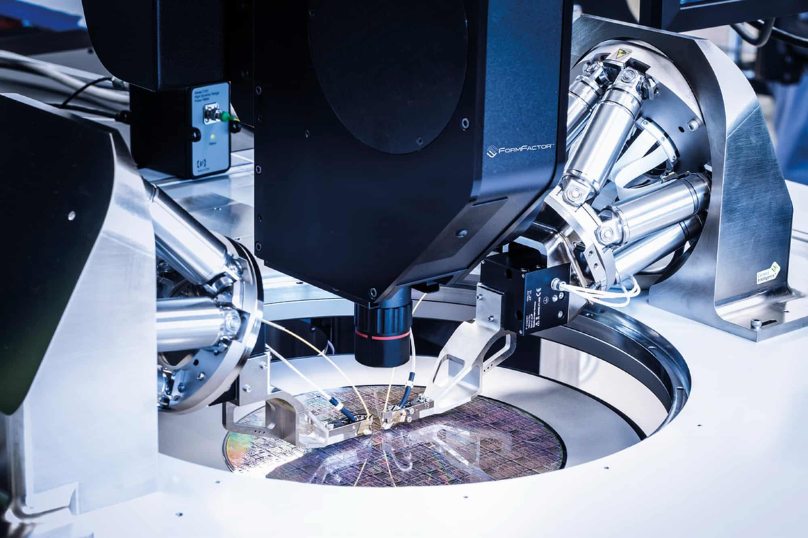
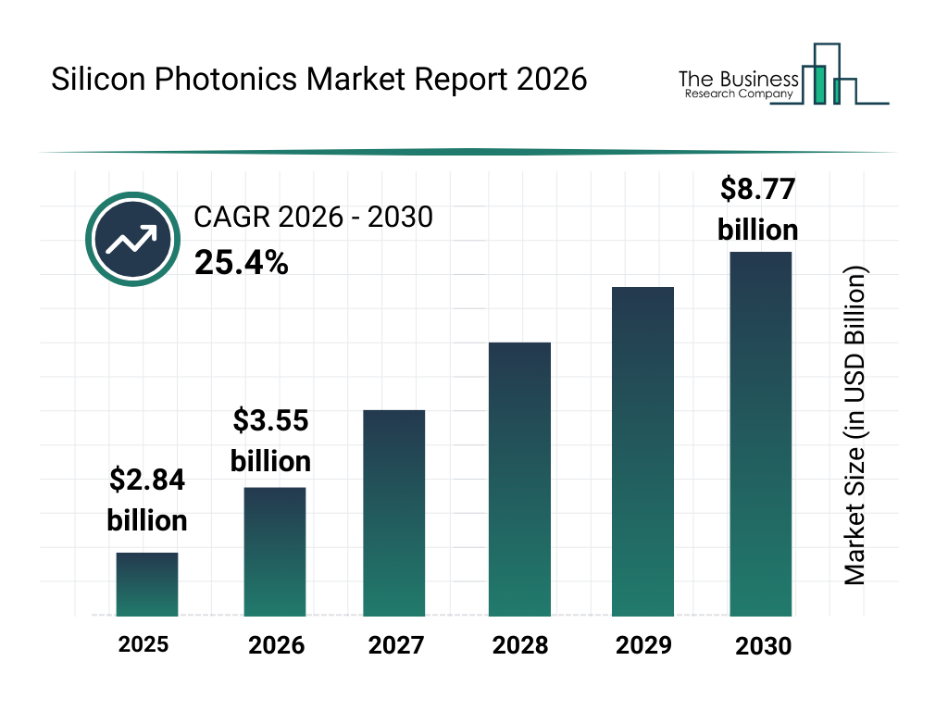
INDUSTRY CHALLENGES
[1]
70-80% of photonics costs are from packaging, requiring costly proprietary alignment systems
Page 2
[2]
[1] L. Ranno et al., “Integrated Photonics Packaging: Challenges and Opportunities,” ACS photonics, vol. 9, no. 11, pp. 3467–3485, Oct. 2022, doi: https://doi.org/10.1021/acsphotonics.2c00891.
[2] The Business Research Company, “Silicon Photonics Market Report 2026,” Jan. 2026. Available: https://www.thebusinessresearchcompany.com/report/silicon-photonics-global-market-report

Slide 3

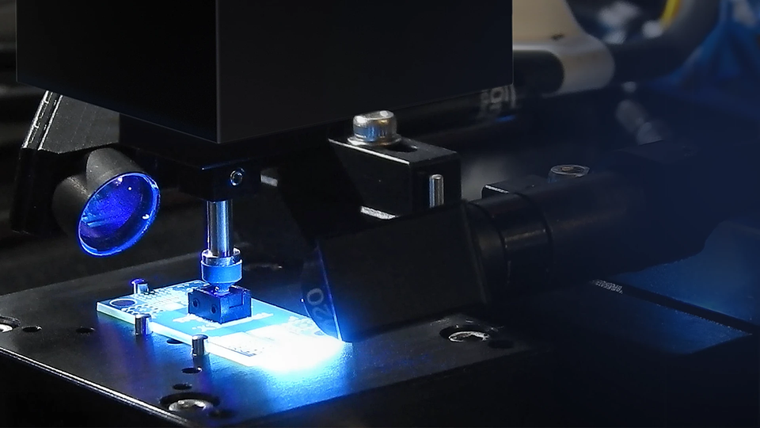
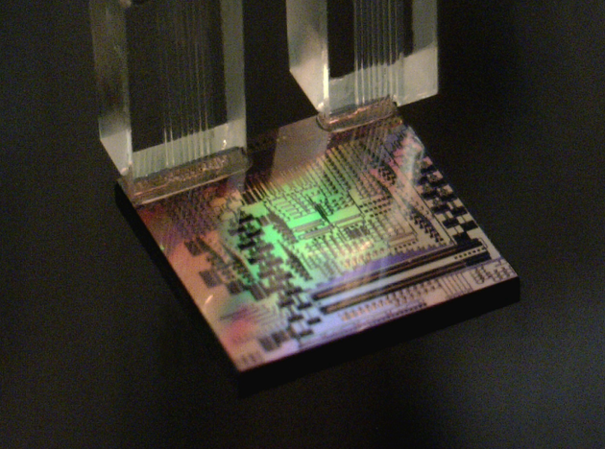
VALUE PROPOSITION
2
4
Budget build
Open
source
<$5k
1
3
5.7
Custom setup
Democratize
proprietary alignment
feedback
systems
<μm
steps to align
precision

Slide 4
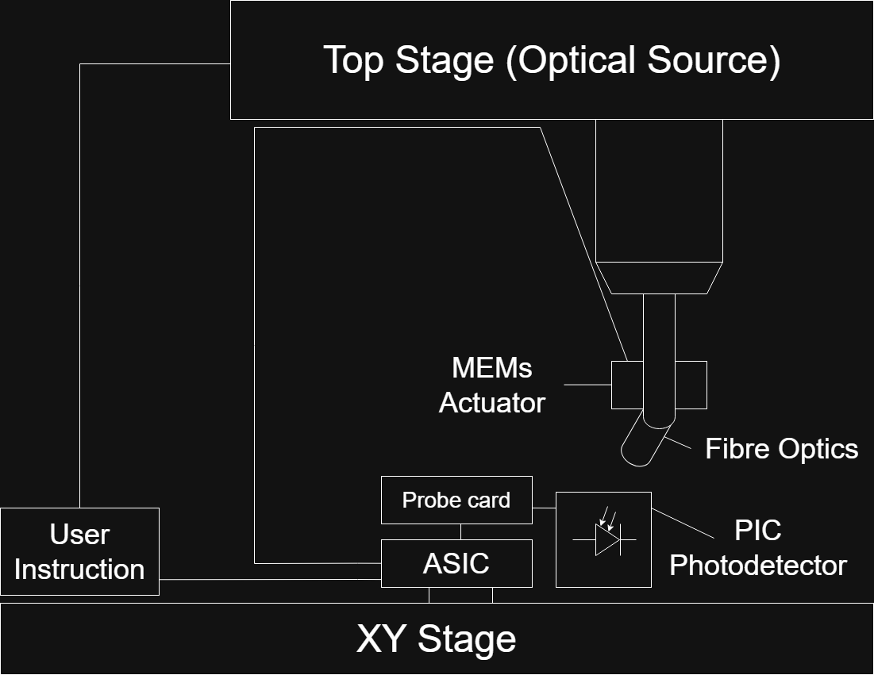
SETUP

Slide 5
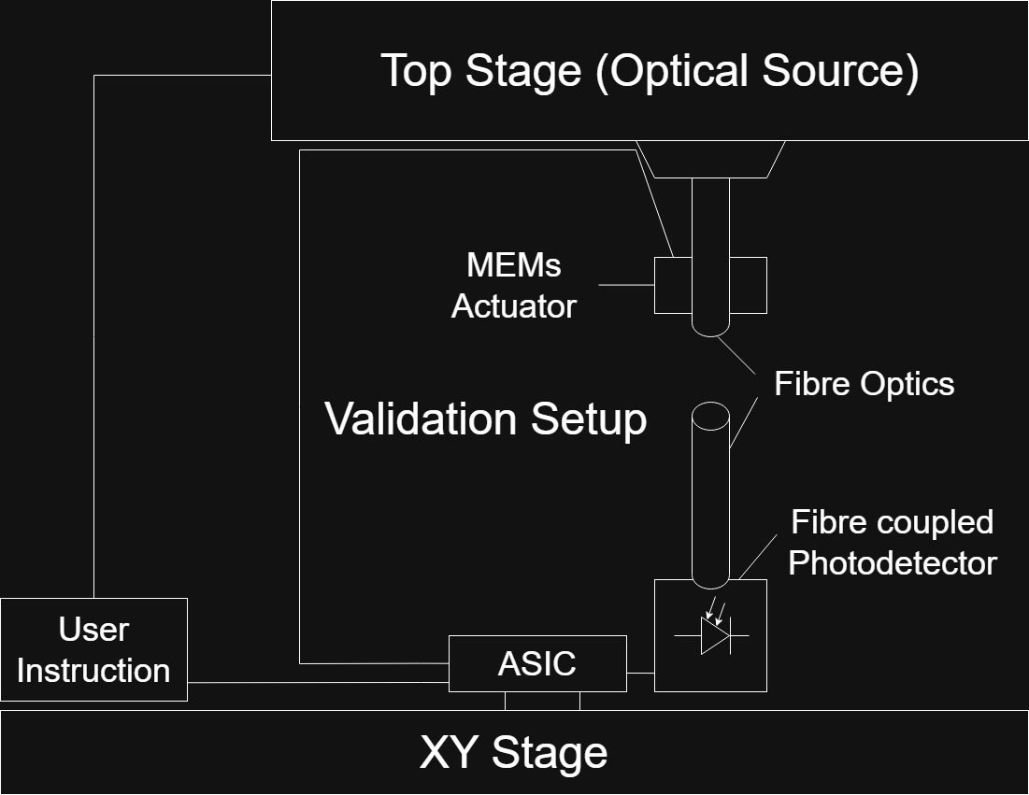
TEST SETUP

Slide 6
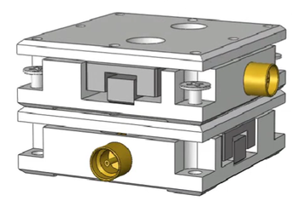
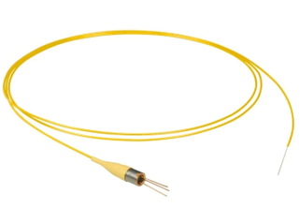
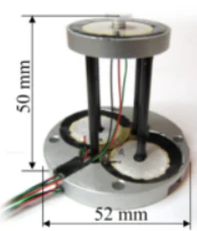
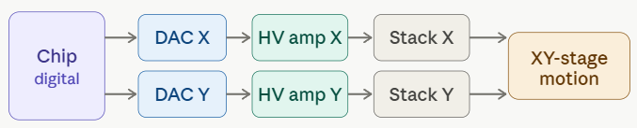

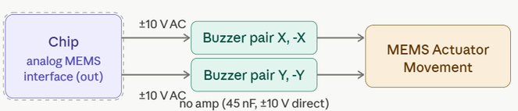
INTERFACES
MEMS
Actuator [2]
XY-Stage [1]
Photodetector
Thorlabs FDSP625 Pigtailed Si Photodiode
Buzzer-Scanner (Wang et al. 2013)
Link: https://doi.org/10.1016/j.ohx.2022.e00317
Estimated Price: less than $883
Key Specifications:
Sensitivity: 25.0 nm/V
Resolution:
Backlash: 160 – 195 nm
Step error: ~ 7%
Link: https://www.thorlabs.com/thorproduct.cfm?partnumber=FDSP625
Estimated Price: $178.32
Key Specifications:
Spectral Band: 320 nm to 1000 nm
Response Speed: 700 ps rise/fall time
Noise: 0.01 nA dark current
Link:
https://doi.org/10.1088/0957-4484/24/45/455503
Estimated Price: less than $125 (without DAQ)
Key Specifications:
XY Range: 5 µm
Nonlinearity: 2.11% X / 2.73% Y
Noise / Resolution: ~0.06 nm
Resonance: ~360 Hz (X/Y)
[3] H.-S. Liao et al., HardwareX, vol. 11, p. e00317, 2022.
[4] W.-M. Wang et al., Nanotechnology, vol. 24, p. 455503, 2013.

Slide 7
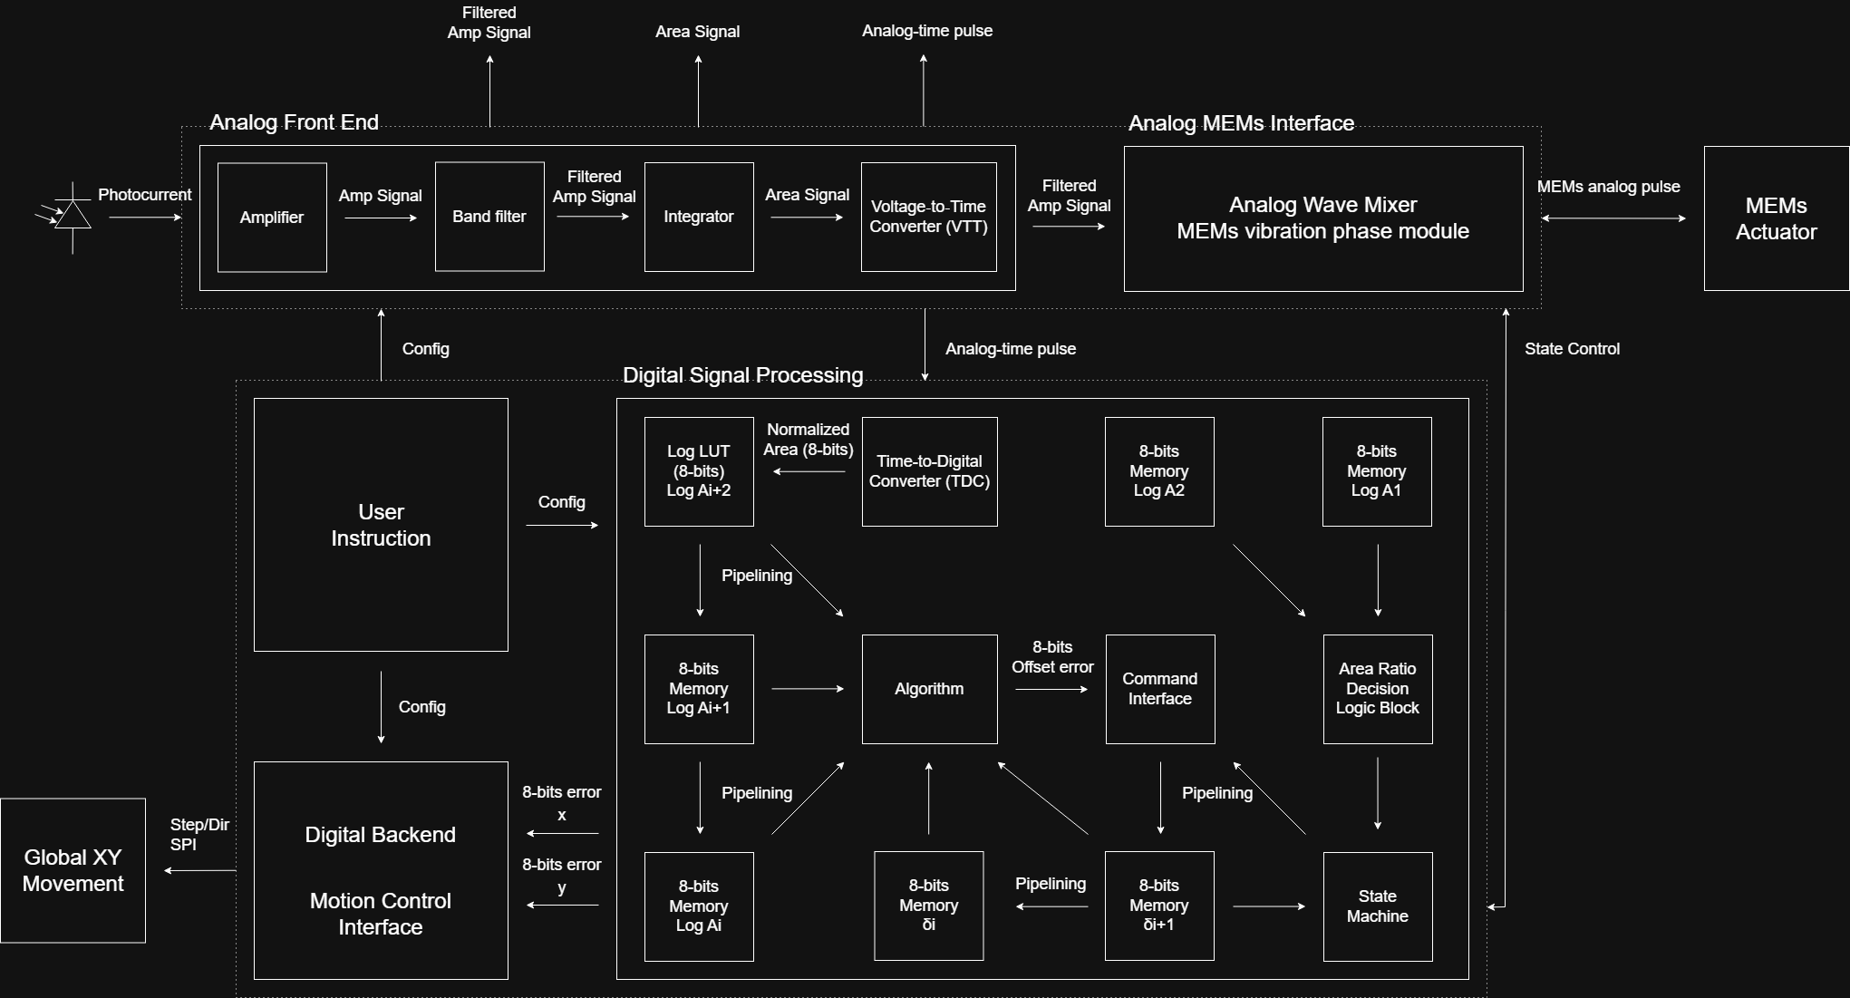
Pin allocation:
Power:
1. Analog
2. Digital
Input:
1. Photocurrent (analog)
2. User instruction config (digital)
Output:
1. Filtered Amp Signal (analog)
2. Area Signal (analog)
3. Analog-time pulse (analog)
4. Offset direction (digital)
5. Normalized Area (digital)
6. Error x (digital)
7. Error y (digital)
8. Global motion x control (digital)
9. Global motion y control (digital)
10. MEMs control (analog)
11. Analog Wave Mixer (analog)
Total pin count: 15

Slide 8
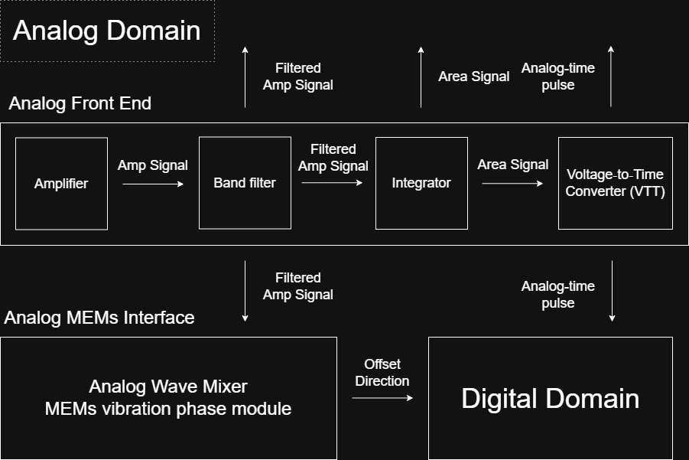
ANALOG DOMAIN
AFE & MEMS WAVE MIXER

Slide 9
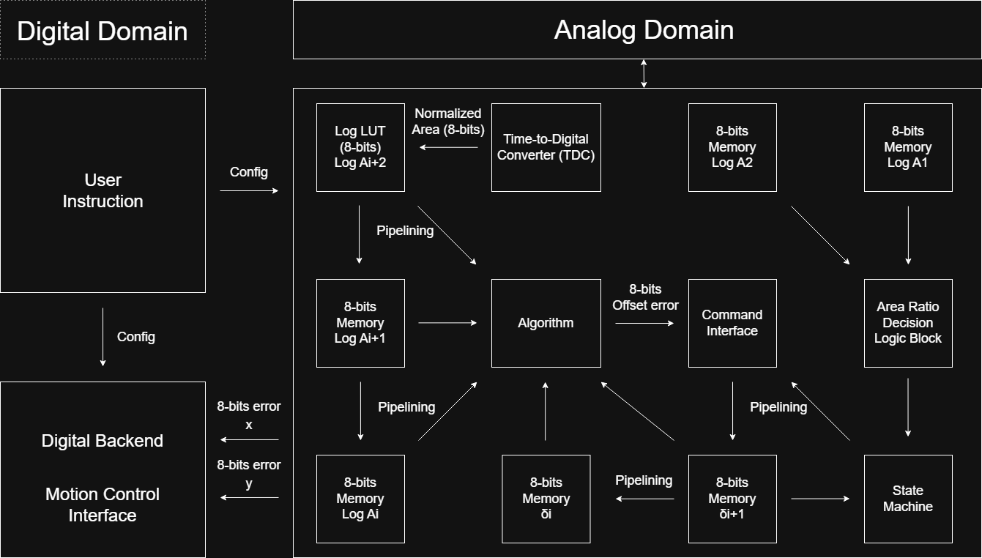
DIGITAL
DOMAIN

Slide 10

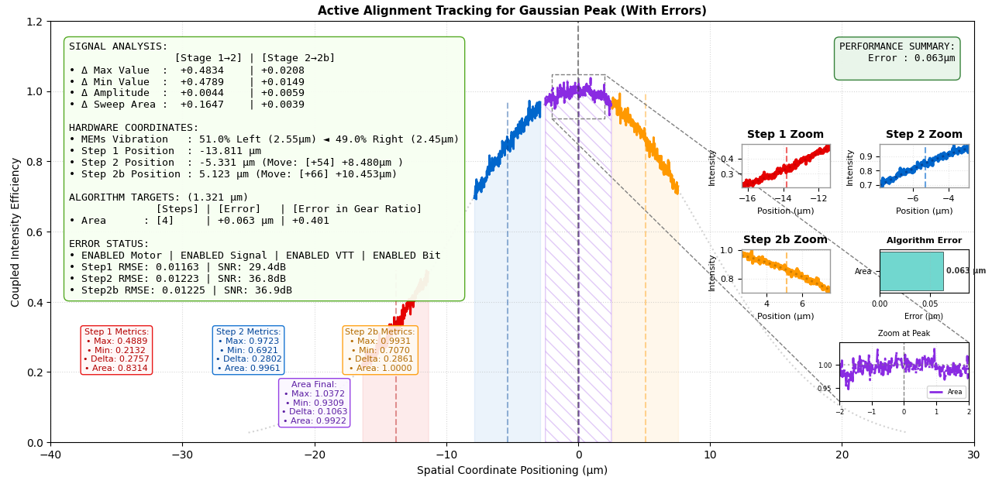
SIGNAL PROCESSING ALGORITHM
Three-Point Gaussian Area Method
3-Point Sampling Workflow :
Readout – Boot and sweep
User config movement and sweep
Smart movement and sweep
Iterate until alignment and stop
[5] J. Li, J. D. Valentine, and A. E. Rana, Nucl. Instrum. Methods Phys. Res. A, vol. 422, no. 1–3, pp. 438–443, 1999.

Slide 11
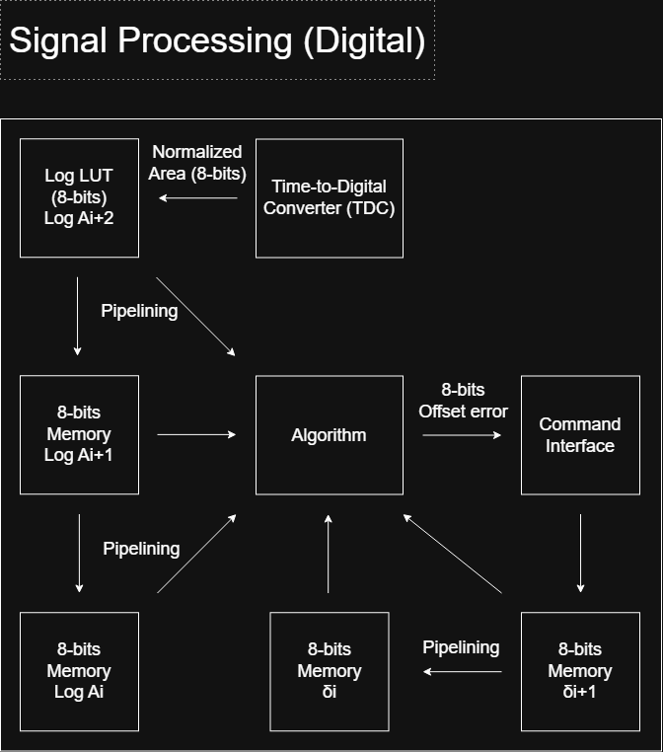
SIGNAL PROCESSING ALGORITHM
20K+

Slide 12
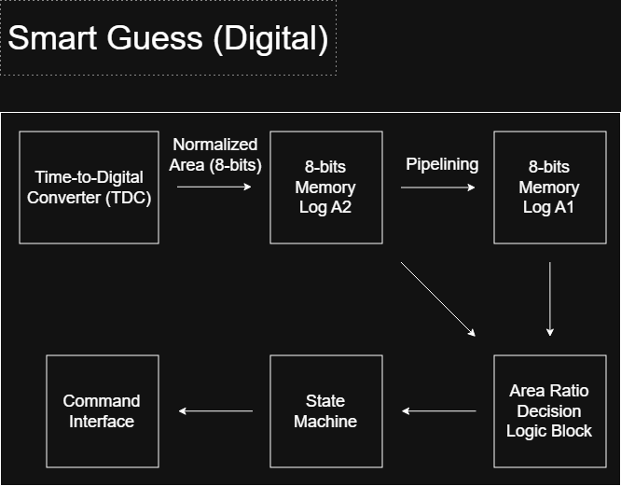
3-POINT SAMPLING WORKFLOW
Readout – Boot and sweep
User config movement and sweep
Smart movement and sweep
Iterate until alignment and stop
20K+

Slide 13
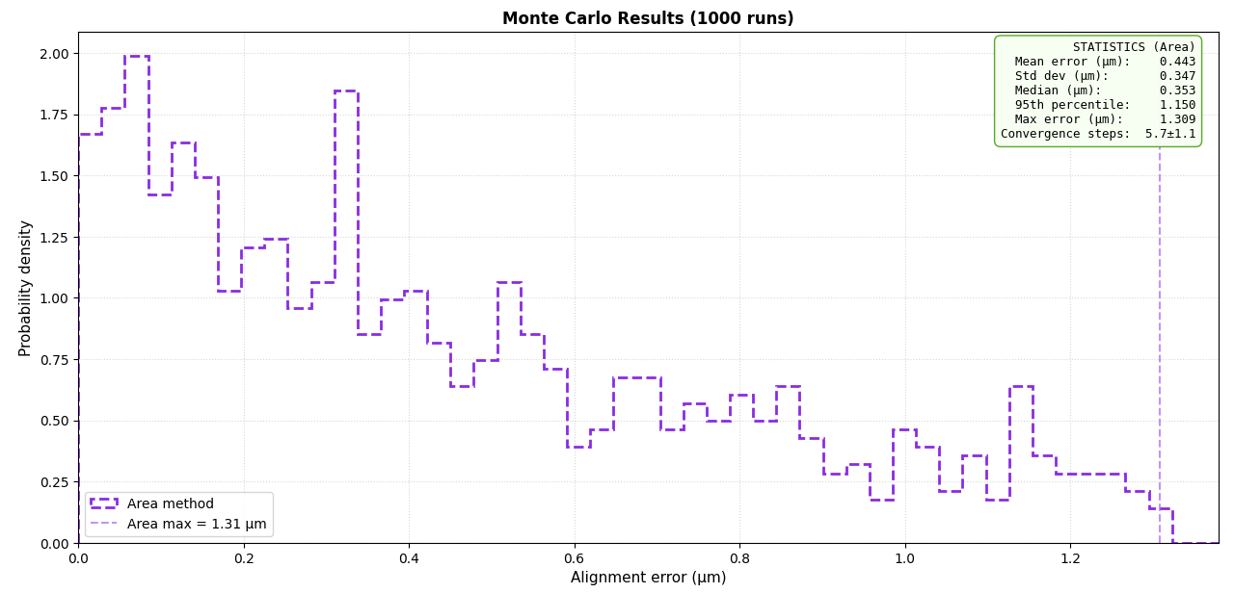
SIMULATION RESULTS
Monte Carlo Simulation
Active alignment Tracking for Gaussian Peak. (WIth Errors)
Average Convergence Steps to 1% Transmission loss 5.7 ± 1.1

Slide 14






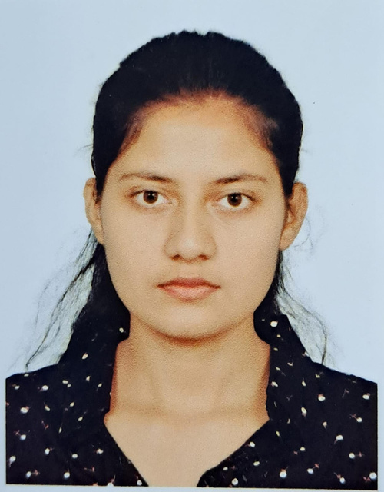

OUR TEAM
TIM (TEAM LEAD)
HKUST CHEM (UG)
UW HACKERFAB UWASIC
ABRAAR
TMU CE (UG)
LCRAIN
BELKACEM
UT EE (PHD)
AUTOMATION LAB
NITIN
UCSB EE (PG)
MEDIATEK
AMS DESIGN ENGINEER
PROJECT INFO
THANK
YOU
REZA
UCD ECE
(PG)
VICTORIA
UW NE (UG)
IQC URA
UWASIC
ASHMITA
UCD ECE
(PG)

